Slide 1
Droughts, Burned Areas and Elections
A visual exploration
Notes:
Background
I live in Saxony which is and has historically been the most right-wing region of Germany. It is also home to many climate change deniers.
Saxony has suffered from severe droughts every year since 2018
This year there have already been two incidents of wildfires in nearby regions which affected the air quality in Dresden, the capital of Saxony
I can actually smell the scent of wildfire while I am giving this presentation
The experience of living in Saxony for 9 years has led me to the following research question: Is there a connection between an increase in droughts and the way people vote? Can we build a hypothesis by visualising historic data on droughts and election results?
For the purposes of this project I will take a closer look at available data from Germany (1952- 2022) and the United States (2000-2016).
Since data from the United states is more readily available in processable formats there is a possibility that this analysis will only apply for the United States. The biggest challenge of this project is to match available data on drought to national voting districts. And to plot this on a filled map.

Slide 2
Challenge
Finding data on droughts, burned area/ or wildfires, and elections results for a single country
Finding data on the county level
Finiding data which spans over a longer period of time
Finding available data in csv format

Slide 3
Available Data
Found data for the United States from three different sources
United States Drought Monitor
Harvard Dataverse
Global Wildfire Information System
The combined data covers the time period from 2004-2016
The data for burned areas, however, covers the federal state level but not the county level

Slide 4
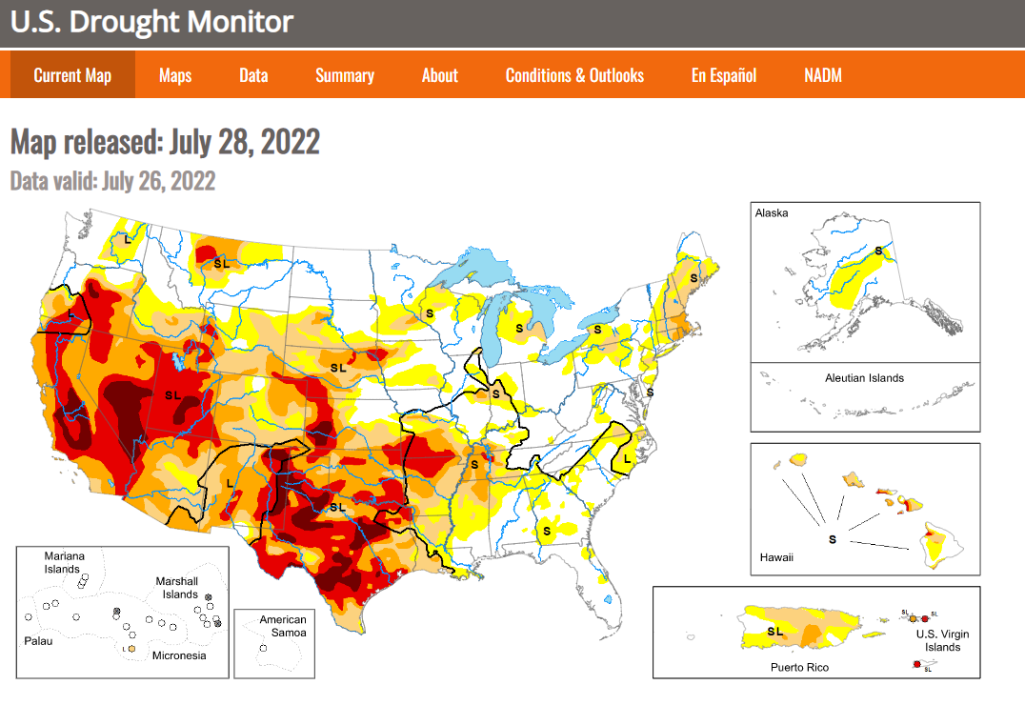

Slide 5
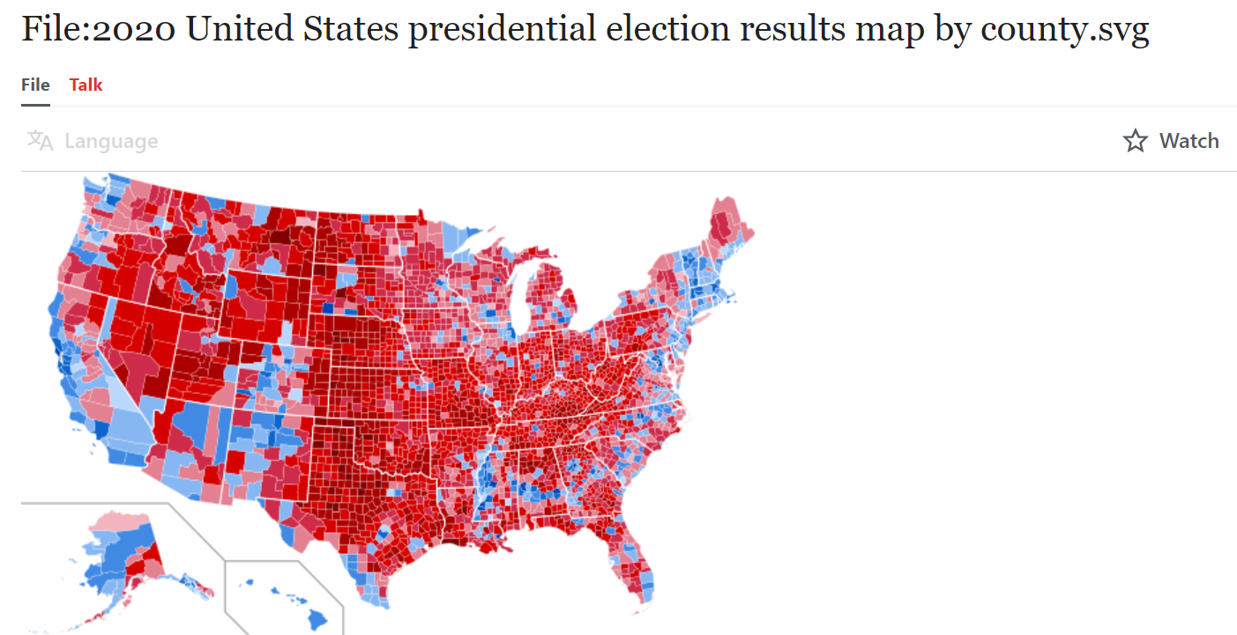

Slide 6
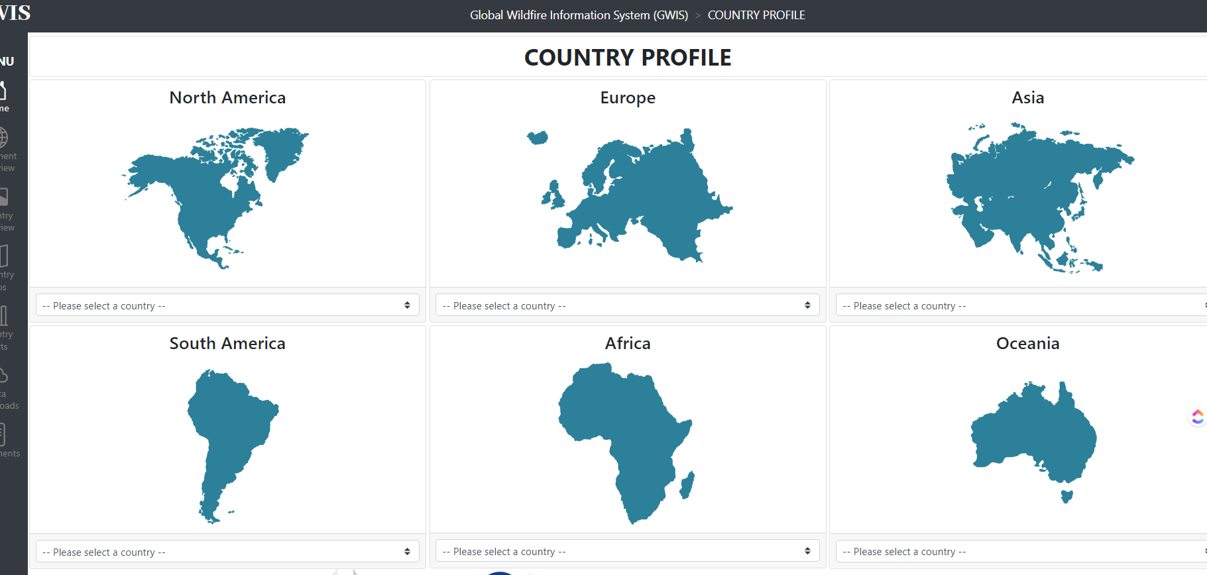
Burned Area

Slide 7
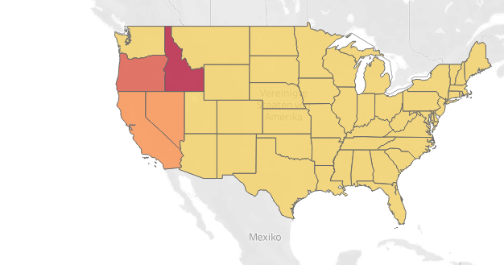
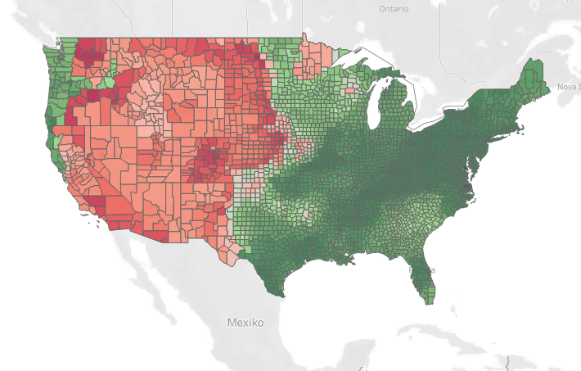
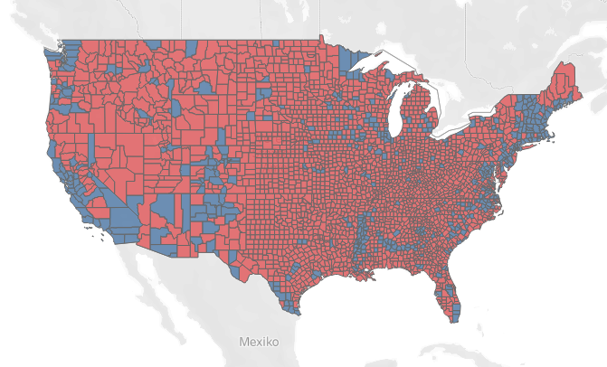
Status Quo
Created animated maps for droughts, burned Areas, and election results

Slide 8
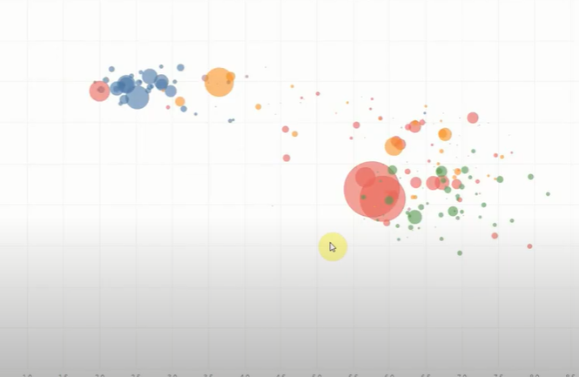
Next up
Create an animated scatterplot which brings droughts, burned area and countywise election results into one table
Conclude if a correlation or causation between drought, wildfires, and election results could be further explored

